Slide 1
Maximizing Performance with Memory Optimized Table Variables
Jared Poche
He\him
Database Engineer\Architect

Slide 2




Jared
Poche
Database Engineer\Architect
Former community college teacher
10-year veteran of Microsoft CSS
SQL Saturday speaker
Group By and PASS Summit speaker
Blogging since 2019
@sqljared
/jared-poche
Sqljared.com

Slide 3
Expectations
Intermediate/Advanced level
Tuned for high concurrency
Goals
Multiple uses for motv
Reducing buffer latch waits
Eliminate unnecessary DMLs
Review SQL SERVER 2019/22 updates

Slide 4

Foundations and Topics
Table variables vs temp tables
Statistics vs tempdb contention
Hot Page contention
Reduce threads
The Halloween Problem
Reduce operations
Key Lookups
Adjacent ID improvement
Reduce DML size
Using Query Store for examples

Slide 5

The Main Problem
“table variables aren't supported in the SQL Server optimizer's cost-based reasoning model. As such, they shouldn't be used when cost-based choices are required to achieve an efficient query plan. Temporary tables are preferred when cost-based choices are required.”
Assumes a table variable has 1 row
Bad estimates can yield bad results
Improved in SQL Server 2019

Slide 6
TempDB Contention
Three main approaches
Trace flags (1118 and 1117)
More tempdb files
Create fewer objects
Setup creating multiple tempdb files (SQL Server 2016+)
Memory-optimized tempdb metadata (SQL Server 2019+)
Shared GAM\SGAM Updates (SQL Server 2022+)

Slide 7
Case Study #1: Temp table replacement
Multiple temp tables
Many UPDATEs to the tables
Complex logic and conditionals
Significant buffer latch waits
Replaced multiple temp tables with motv
Added a join to the insert, consolidated
Reduced duration by 50-60%

Slide 8
Bulk Procedures and Hot Page Contention
Less database time
Fewer threads
Less blocking\latching
Fewer round trips
Mind your memory
Consider data size char\varchar
Modify batch size

Slide 9
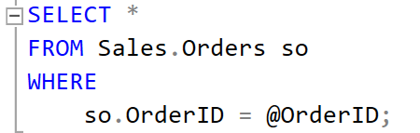
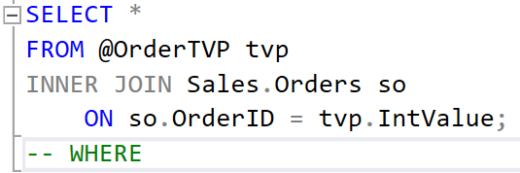
Basic query
Bulk query

Slide 10
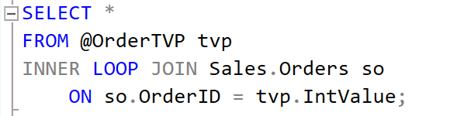
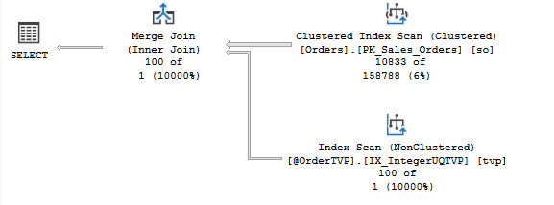
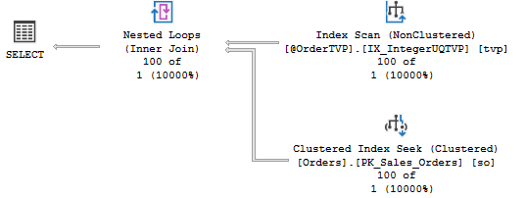
Cost-Based Choices?
The Problem
The Solution

Slide 11
Hot Page contention Bulk INSERT – Test Setup
Test options
Serial execution in SSMS
Parallel executions with SQL Query Stress (see comment)
Batched execution in SSMS
Confirm with Query Store

Slide 12
Consider Memory for MOTV
Memory optimized objects do consume memory
Can’t limit TVPs in procedures
Estimate memory usage and discuss with developers
Consider column sizes
# of input rows
Parallel calls
Suspect string fields

Slide 13
The Halloween Problem
Can affect any DML operation
Don’t try to write fields you query from
Can operate on the same row multiple times
Index movement is key
Halloween Protections prevent the problem
Uses a blocking operator to separate reads and writes (eager spool, sort)
Bad for performance

Slide 14
Manual Halloween Protection
Separate the read and write into separate statements
SELECT data into a motv
Include all columns, calculations needed for DML
Filter redundant rows
Perform the DML using the motv
Halloween Protections now unnecessary

Slide 15
Conditional DML
With Manual Halloween, we can skip unnecessary DMLs
Query data for the DML into motv
IF EXISTS SELECT statement to decide:
If there is no change, don’t run the UPDATE
If the row exists in the table, don’t run the INSERT
If the row doesn’t exist, don’t run the DELETE

Slide 16
Conditional DML (cont.)
Skipping INSERT\UPDATE\DELETE statements:
Trade U\X locks for SH locks
Skip trigger executions
Skip foreign key validation
Skips the most expensive operator
Doesn’t involve storage

Slide 17
Halloween Demos
Run scripts #31-34
Creates and executes 3 procedures
Query store shows modest improvement
UpdateAll is very fast to begin with
Run scripts #40-47
Massive improvement from skipping the UPDATE statement

Slide 18
Case Study #2: Halloween UPDATE
Large procedure updating primary table and related tables
Focusing on one statement updating a related table
heavy buffer latch waits
Indexes good, simple plan: hot page
Manual Halloween
From 1.4 milliseconds to 0.4
19.9 million statement executions to 33k

Slide 19
Case Study #3: Halloween Upsert proc
Query TVP and base table into MOTV
If table values are NULL, INSERT
Improved Halloween logic
Did not insert rows with no change into the motv
Reduced update time by 25%

Slide 20
Adjacent table IDs (Key Lookup)
DML operations using IDs from a related table
Query using non-clustered index
Key lookup
Improvement: create MOTV with local IDs
Eliminates key lookup
Fewer pages locked during DML
Less buffer latch contention

Slide 21
Key Lookup Demos
Run scripts #51-54
Review plans #55 and 56
Removed key lookup, slight improvement
Run scripts #61-64
Compare similar statements in Query Store output
Huge improvement in adjacent DELETEs

Slide 22
Case Study #4: Garbage Collection Adjacent
Garbage collection on main table and one related table
80% of procedure’s duration is DELETE on adjacent table
Heavy buffer latch waits: 85%
DELETE uses related ID
Non-clustered index and key lookup
Populated new MOTV with local Primary Key
60% duration drop for procedure

Slide 23
Case Study #5: DELETE/INSERT Proc
DELETEs and INSERTs rows
If we did an UPDATE, we’d still need other DMLs
Input TVP uses IDs from a related table
Populated new MOTV with local IDs;
Key lookup eliminated from DELETE
Duration dropped from 40ms to 7ms
82.5% reduction

Slide 24
SQL Server 2019 features
Intelligent Query Processing
Table Variable Deferred Compilation
Results in the actual cardinality being used
Memory-Optimized TempDB Metadata
System tables are optimized, not #temptables

Slide 25
SQL Server 2022 features
Intelligent Query Processing
Cardinality estimation feedback
Memory grant feedback
Optimized plan forcing
Performance
System page latch concurrency enhancements: allows concurrent updates in the GAM and SGAM pages (details and more details)

Slide 26
Maximizing Performance with Memory Optimized Table Variables
Jared Poche
@sqljared
/jared-poche
Sqljared.com

